Slide 1
Livy 설치
https://docs.knime.com/2018-12/bigdata_spark_installation_guide/index.html
https://docs.knime.org/2019-06/bigdata_extensions_admin_guide/bigdata_extensions_admin_guide.pdf
CDH 6.x 버전 기준으로 설명

Slide 2
Cloudera 환경에서 설치를 위한 준비
(in server01)
# cd ~/work
# wget https://download.knime.com/bigdata/cdh6/livy/0.5.0.knime3/csd/LIVY-0.5.0.knime3-cdh6.jar
# cp -p LIVY-0.5.0.knime3-cdh6.jar /opt/cloudera/csd/.
(# wget https://download.knime.org/bigdata/cdh6/livy/0.5.0.knime3/parcels/LIVY-0.5.0.knime3-cdh6-el7.parcel
(# wget https://download.knime.org/bigdata/cdh6/livy/0.5.0.knime3/parcels/LIVY-0.5.0.knime3-cdh6-el7.parcel.sha
(# cp -p LIVY-0.5.0.knime3-cdh6-el7.parcel /opt/cloudera/parcel-repo/.)
(# cp -p LIVY-0.5.0.knime3-cdh6-el7.parcel.sha /opt/cloudera/parcel-repo/.)
# systemctl restart cloudera-scm-server

Slide 3
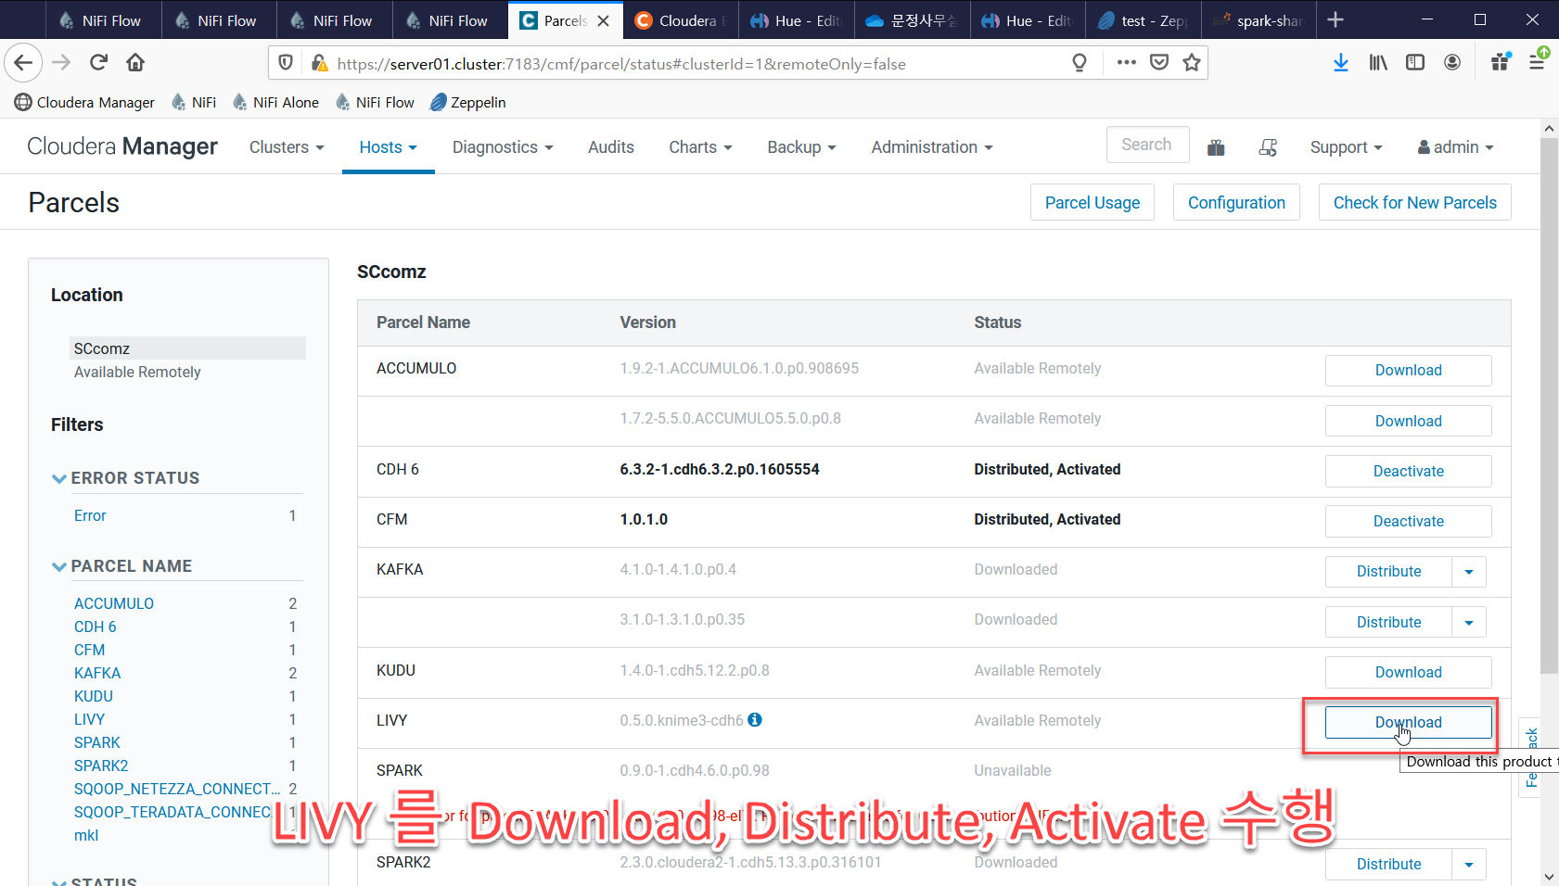

Slide 4
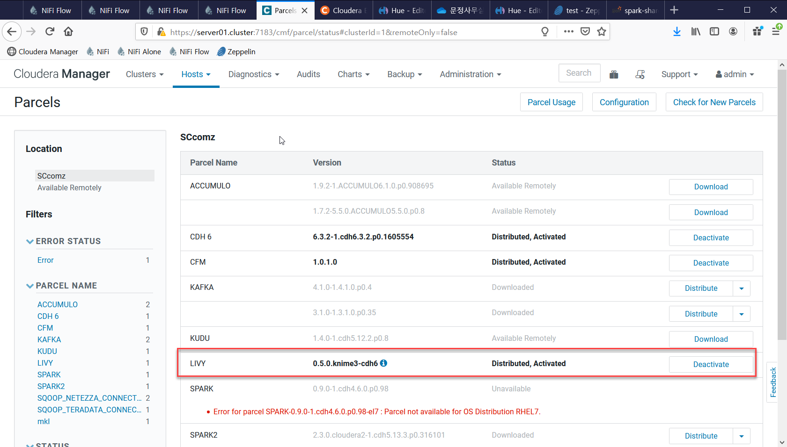

Slide 5
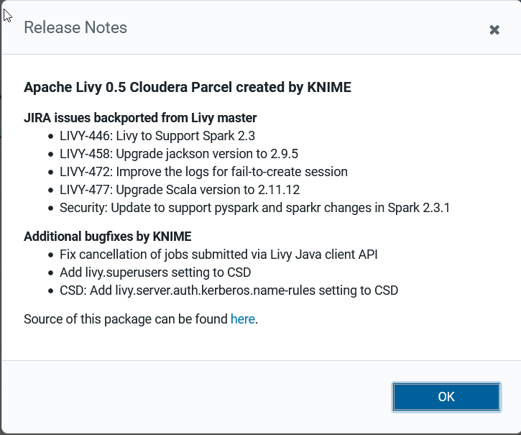

Slide 7
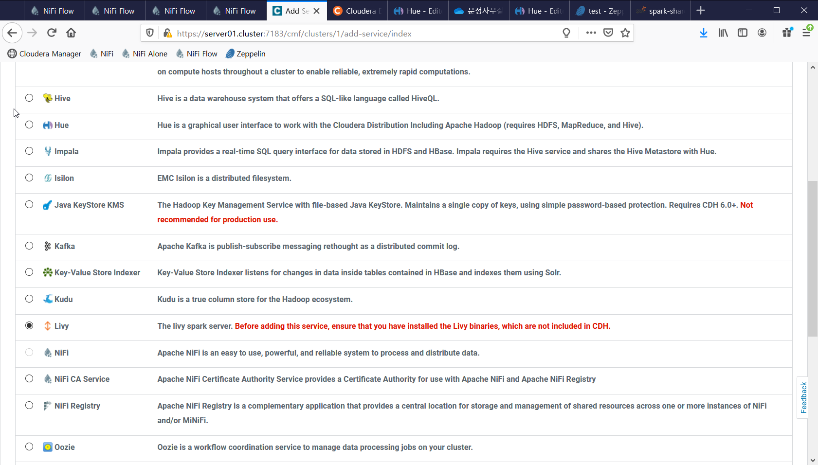

Slide 8
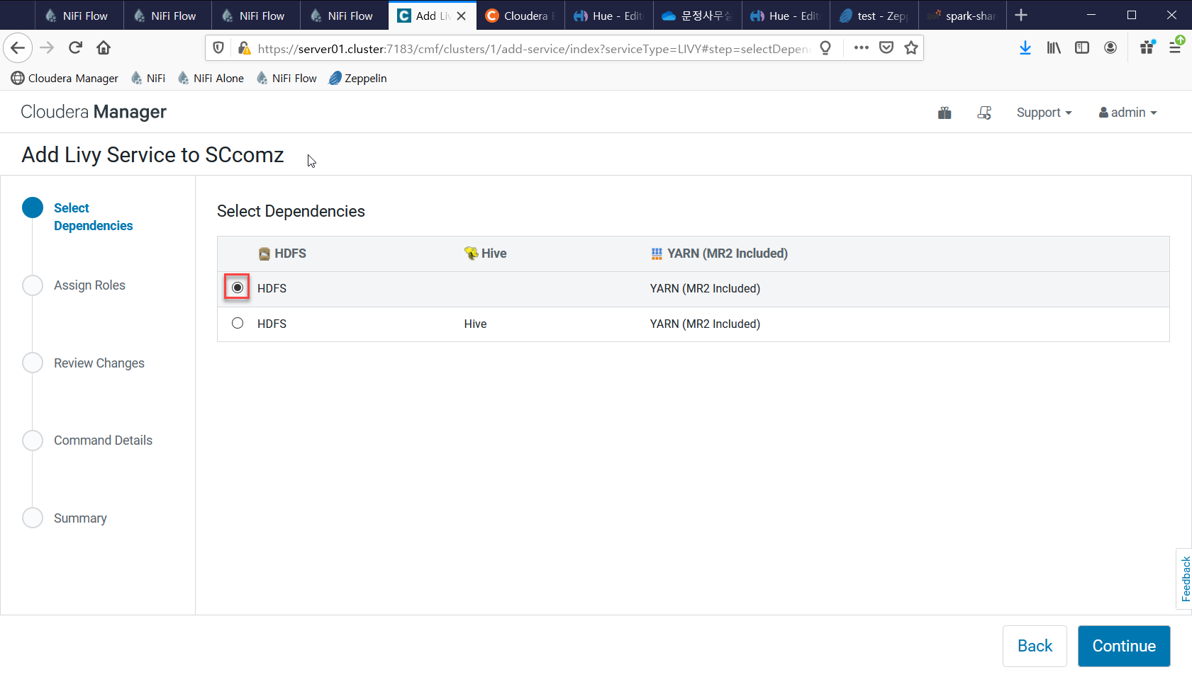

Slide 9
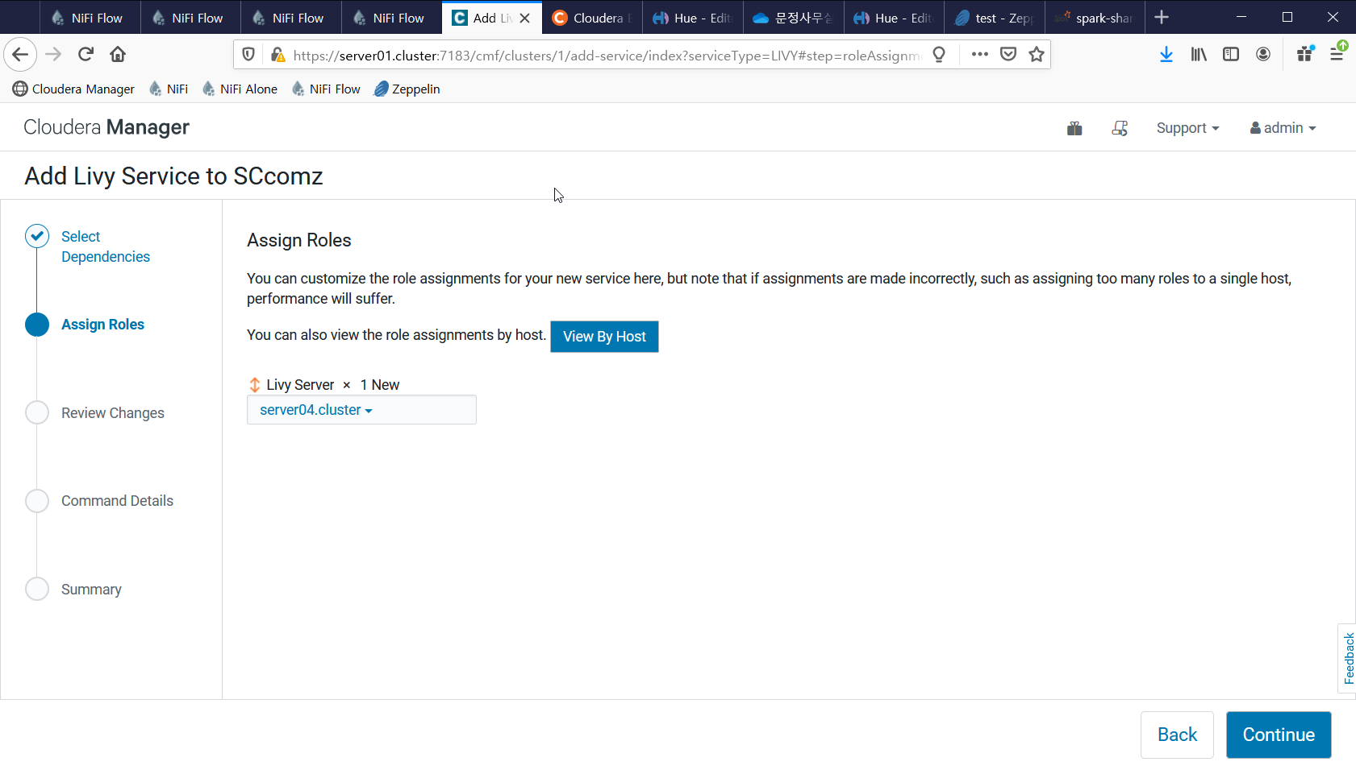

Slide 10
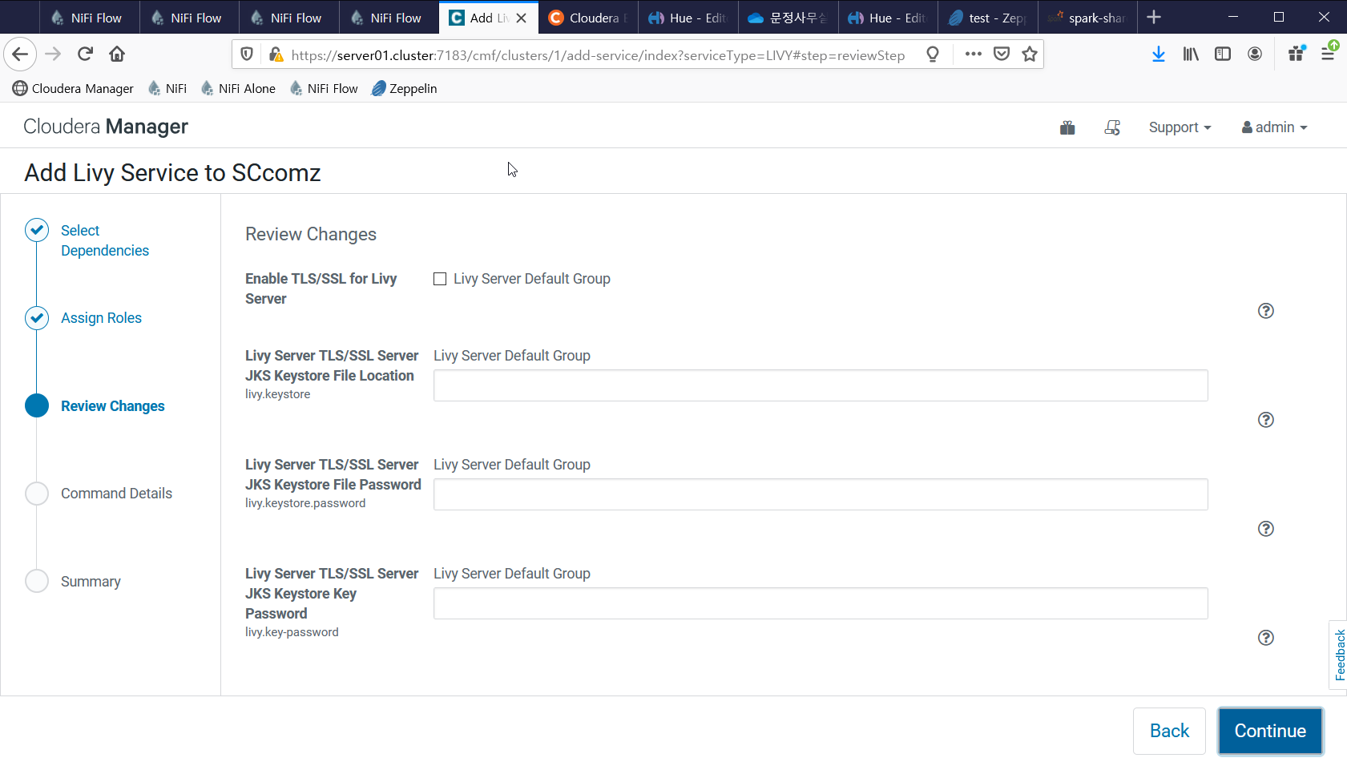

Slide 11
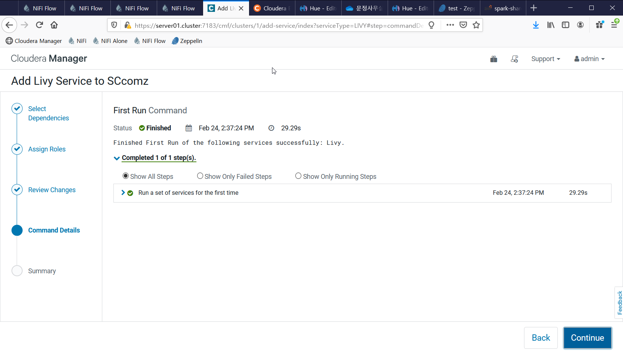

Slide 12
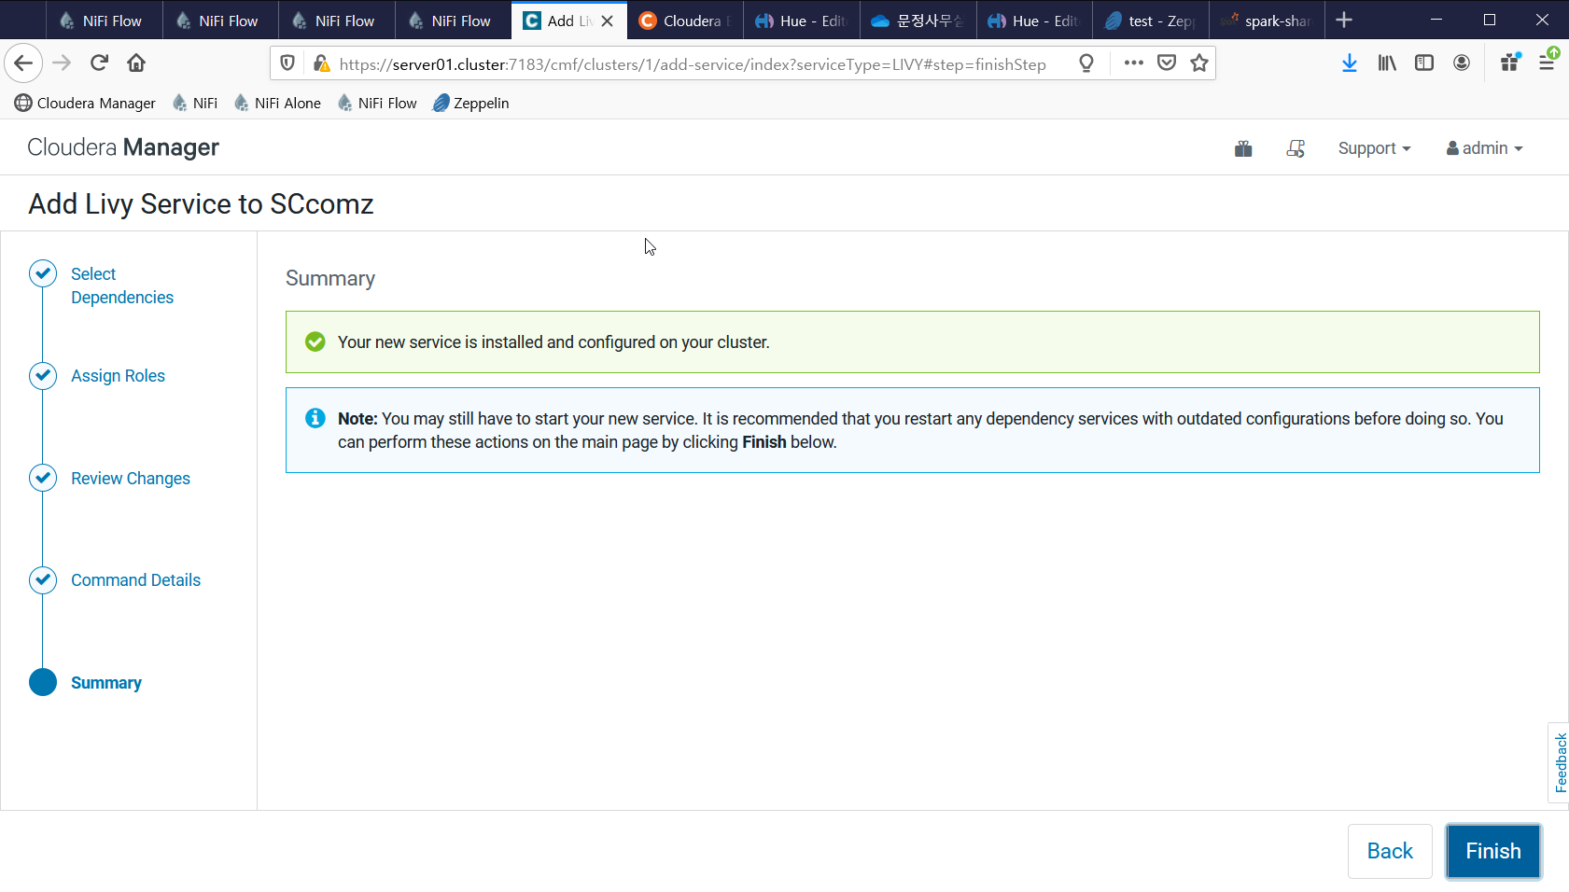

Slide 14
